Slide 1

Norm Ninja

Slide 2



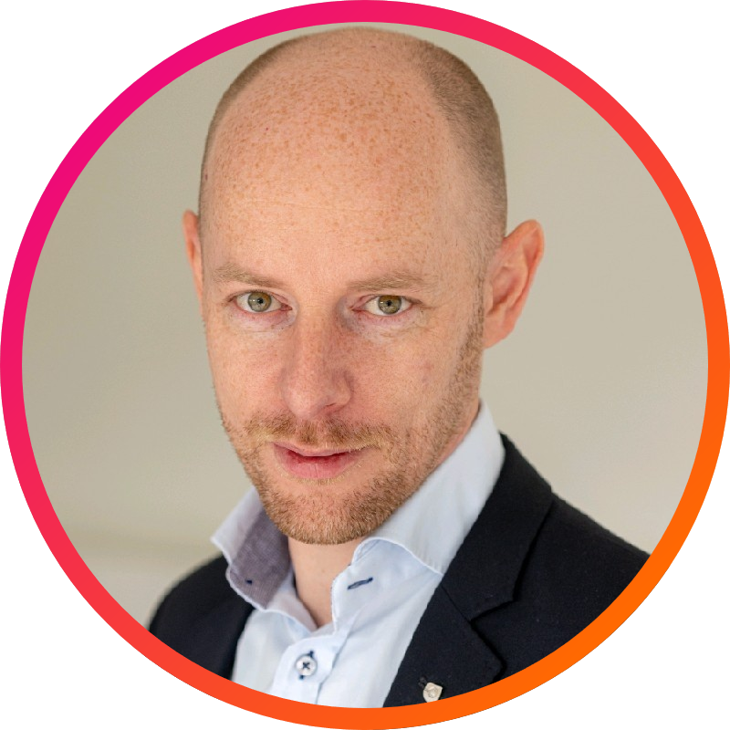
The broad expertise behind the story
Tim
security EXPERT in information and privacY (CISM, CGEIT, CISSP, CIPP/E, CIPM) backed by 15 years of hands-on CISO experience
TOM
CYBER, Quality, and Compliance EXPERT with 20 YEARS' EXPERIENCE LEADING Service TEAMS, ARCHITECURE PRACTICES AND ENTERPRISE TRANSFORMATIONS
Erik
at home in complex multidisciplinary projects and international environments. He is a teacher IN (Agile) Enterprise Architecture.
Jonas
15 YEARS of experience in Enterprise architecture & BUsiness development
Notes:
Key Message: Highlight the expertise behind the solution. Emphasize credibility by presenting team members with roles that reinforce the security and compliance background.

Slide 3
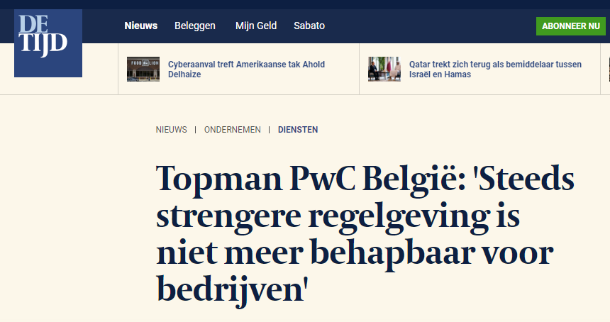
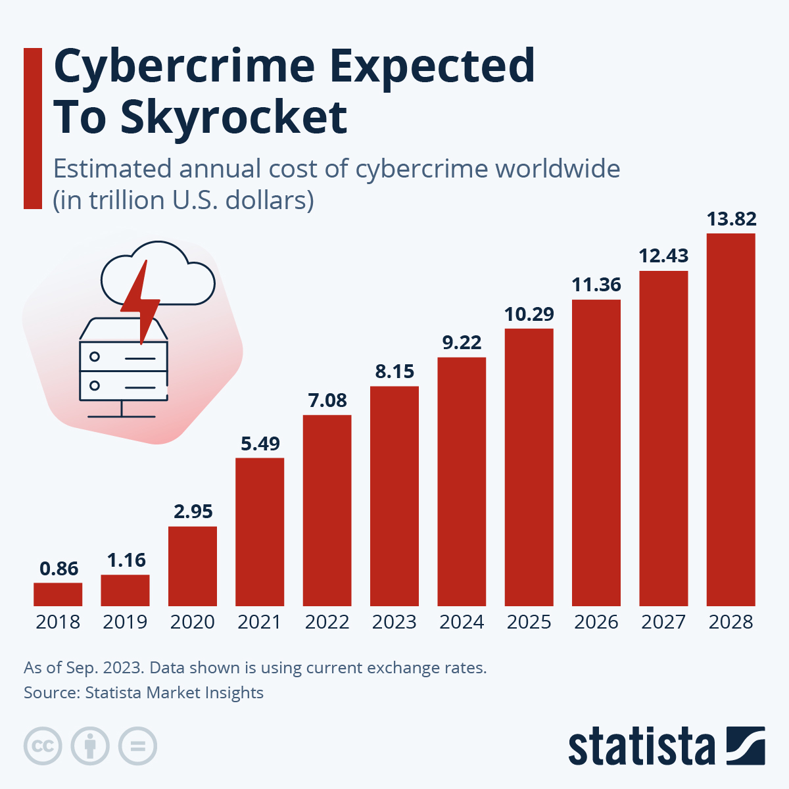
SMEs struggle to meet growing risk and compliance demands
EVER INCREASING RISK EXPOSURE
+
REGULATION GETTING MORE COMPLEX
REINFORCED BY
Lack of expertise & Limited resources
RESULTING IN
INABILITY to demonstrate cybersecurity compliance
Leading to
financial, trust & reputation damage and/or operational inefficiencies
Notes:
Many organizations lack adequate cybersecurity risk visibility due to limited resources and expertise, which can lead to severe financial, reputational, and operational consequences.

Slide 4







Market Opportunities
The EU market is dominated by SMEs, with over 99% of businesses in this sector. Despite their prevalence, only around 20% of these SMEs use Governance, Risk Management, and Compliance (GRC) tools, leaving a vast number operating without the formal frameworks needed to manage security and regulatory risks effectively.
Digital Adoption
Budget Constraints
Regulatory Compliance
Complex security tools
EU SMEs are increasingly adopting digital tools, raising cybersecurity concerns.
Many SMEs lack the resources to invest in comprehensive information security tools.
Affordable, easy-to-deploy security tools tailored to specific needs present significant opportunities.
Compliance with GDPR, NIS2, and Cybersecurity Resilience Act increases demand for security solutions.
Notes:
These factors create a growing demand for affordable, easy-to-implement, and scalable information security tools.

Slide 5




Why the standard compliance circle isn’t working
Are we doing the right things as SME?
How to adapt things to our specific situation?
Which actions are required? And how do we implement these?
When is it good enough?
Very complex tooling, unfit for SME
How do we even execute an assessment, and on what?​
Very complex tooling, unfit for SME
Very complex tooling, unfit for SME
4
ACT
Gap Analysis & Reporting
Assessment execution
Assessment Planning
Continuous Monitoring
Strategic Review
Update Policies & Procedures
Implement Corrective Actions
Performance monitoring
3
CHECK
1
PLAN
Action & resource planning
Implement Policies & Procedures
Training and Communication
Data Collection
Identify Requirements
Risk Assessment
Goal Setting
Develop Policies & Procedures
2
DO
How to understand the requirements in our context?
Quantifying risks is difficult
What to do first?
Pragmatic policies for SME are difficult to find.
Limited resources and expertise
What Policies & Procedures do we need? We do not understand these.
Understandable trainings on SME level are hard to find.
Mostly manual processes

Slide 6


A simple, actionable & context-driven solution
The market offers:
Our platform leverages it all for SMEs:
Advise from specialist
Designed for simplicity and your expert level
Guided configuration based on your context
SaaS platforms, Tools, Templates, …
Actionable and intelligent advice on your context and goals
Understand proposed actions, controls, frameworks and legislation.
Newsletters & forums
Keep you informed on what matters
Education
Compare to your industry

Slide 7
Built on streamlined platform capabilities
Knowledge Management
Action Management
Training and Awareness
Evidence Collection
Implementation Tracking
Action & Resource Planning
Configuration Management
Assessment Management
Risk Management
CHECK
Continuous Monitoring
Goal Setting
DO
Organisational Scoping / Intake
Reference Model Creation
Asset Management
PLAN
Assessment Planning
Assessment Execution
Gap Analysis & Reporting
Risk Assessment
Strategy Management
ACT
Regulatory Update
Process Improvement
Strategic Review
Effectiveness Evaluation
Notes:
1) Waarom is deze dubbele loop beter tegenover de traditionele
2) Meer in detail de verschillende blokken (indien meer intresse)
1) Configuration Management
2) Assessment Management
3) Risk Management
4) Action Management
5) Knowledge Management
6) Strategy Management
Bedenking: Mvp: tailered compliance model dat begrijpbaar is. En juiste actie selecteren.

Slide 8
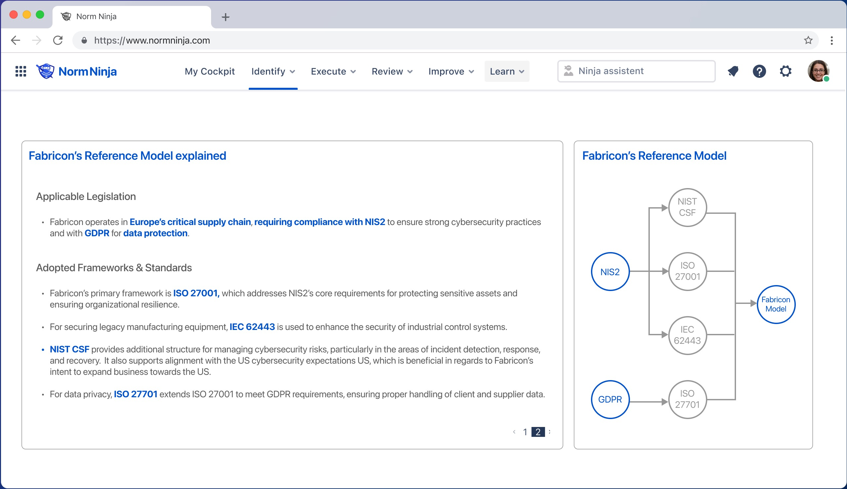
Mock-ups

Slide 9
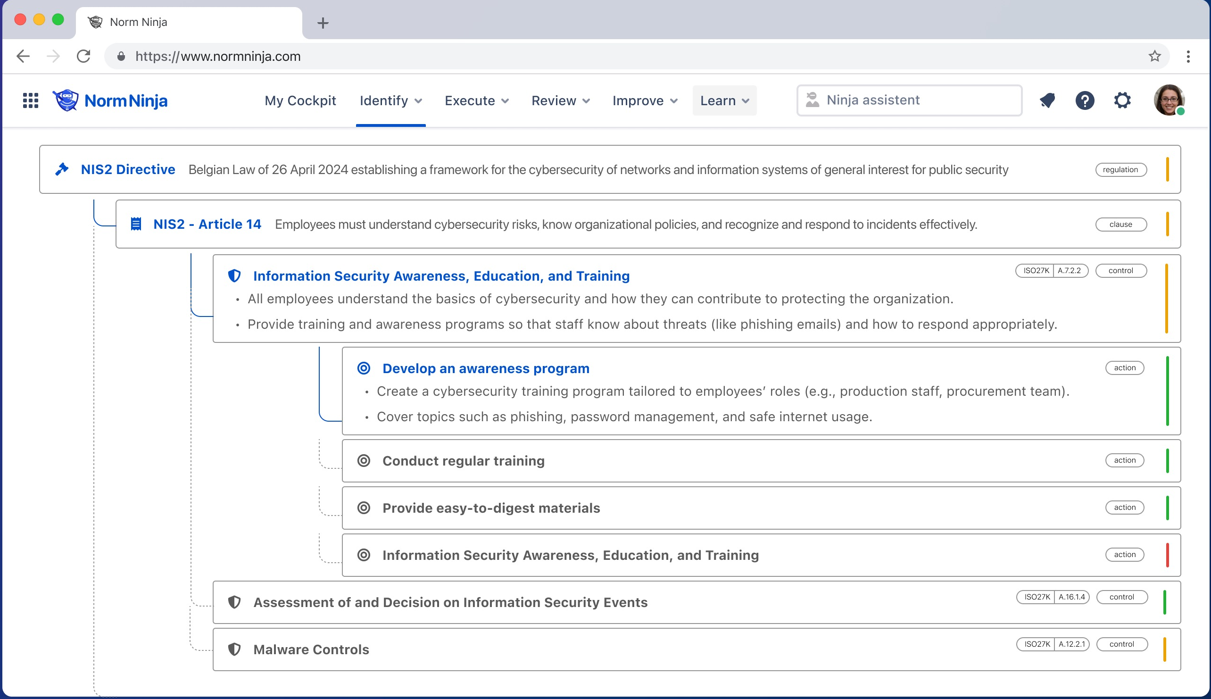
Mock-ups

Slide 10





A business model based on SaaS and collaborations
Primary revenue stream:
SaaS
Secondary revenue stream: Collaboration
Multipliers: Eco-system
Standard version
A monthly subscription fee for access to the platform. The fee is calculated on:
Yearly revenue
Legislation / Standards activated
Functionalities activated (integrations, IAM, …)
Community Access
Implementation partner license
Implementation partners can:
Setup free temporary customer environments
Use multi-tenant management tools
Customize the tool with proprietary content
Receive a kick-back for subscribing customers
Market Place
Sell via our market place:
Your own legislation & standards configurations
System connectors
Functional extensions
…
Premium version
The premium version gives additionally:
User support
Numbers of hours of consultancy
Numbers of hours of legal advice
Creation of internal policies configurations
Referral partners
Consultancy Partners can participate in our support program for premium customers.
Community
A paying customer has access to our community:
Forum
Community explications of topics
Participate in bounty program
Get credits for regular contributions

Slide 11
Our next steps
Viability check
Funding
Design & prototyping

Slide 12
Questions & Feedback

Slide 13
Potential questions for Marc
Feedback on market demand
Where do yo see the biggest needs for SME's for cyber, irrespective of our solution.
Feedback on the Pitch:
Understanding Value:
How well do you think our platform aligns with a demand from SME?
Do you see any risks / pitfalls in market positioning (or others, fe development)
Do you see any opportunities (funding, interested partners)
Do you have an opinion on geographical focus/deployment (local, EU, global,…)
Relevance and Fit:
Which aspects of the solution stood out as particularly valuable or relevant to SMU/Big organisations current challenges?
Are there any features or capabilities that you feel are missing or could be enhanced?
Assessing Perceived Impact:
Business Alignment:
How do you see our solution supporting your efforts to align security with enterprise objectives?
Wat zijn uw parameters om een tool te kopen?
GO TO MARKET
Do you have any tips on go-to-market for this kind of solution?
Gauging Interest and Next Steps:
Interest Level:
Based on what you’ve seen, how interested are you in exploring this solution further?
Would you like to see a deeper technical demo or a use case tailored to your organization?
Barriers and Concerns:
Do you have any concerns or reservations about the solution that we could address?
What factors would you need to evaluate before moving forward with this kind of solution?
Next Steps:
Who else might benefit from seeing this presentation or exploring this solution?
Do you see any concrete partners who we could engage with?

